Slide 1
Traceability
Source: Elizabeth Hull, Ken Jackson and Jeremy Dick, Requirements
Engineering , Second Edition, 2005

Slide 2
Traceability
Traceability is concerned with the relationships between requirements, their sources and the system design
  Source traceability
    Links from requirements to stakeholders who proposed these requirements
  Requirements traceability
    Links between dependent requirements
  Design traceability
    Links from the design to the requirements

Slide 3
Traceability – Contd…
Traceability is very commonly represented in matrix form as an appendix to relevant documents.
The two dimensions identify, for instance, user requirements on one axis and system requirements on the other, with marks in those cells where a relationship exists.

Slide 4
Disadvantages of using matrix form
Large number of statements to index on both axes
Paper or screen is too small to show enough information.
It is very hard working your way through multiple layers of traceability presented in a number of separate matrices.
Information about traceability is separated from the details of the requirements themselves.

Slide 5
Hyper-linked documents
Statements can be highlighted, linked to other statements and traversed in either direction
Problems
  To carry out analysis you may have physically to traverse the link before text at the other end is visible.
  It is hard to spot when the item at the other end of a hyperlink has been deleted, leaving a dangling link, making traceability difficult to maintain.

Slide 6
Elementary Traceability
The simplest form of traceability is achieved by linking statements together using some kind of database support.
It is helpful if linking information is held separately from the documents.
It is essential that statements are independently and uniquely identifiable.

Slide 7
Essential capabilities for implementation of traceability
ability to create links between statements, thus forming relationships;
ability to delete links between statements in a controlled manner;
ability to view simultaneously the text (or other attributes) of statements at both ends of a selected relationship;

Slide 8
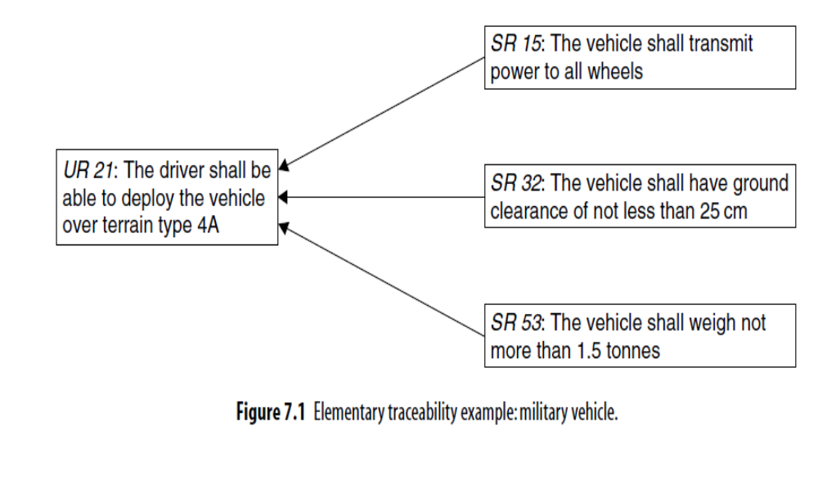
Example-1

Slide 9
Problems …
The intention in this example is that the system requirements are somehow sufficient to satisfy the user requirement.
It is difficult, however, for a non-expert to assess the validity of this assertion.
This is because the reasoning has not been presented.
What is better is to present a “satisfaction argument” for each user requirement.

Slide 10
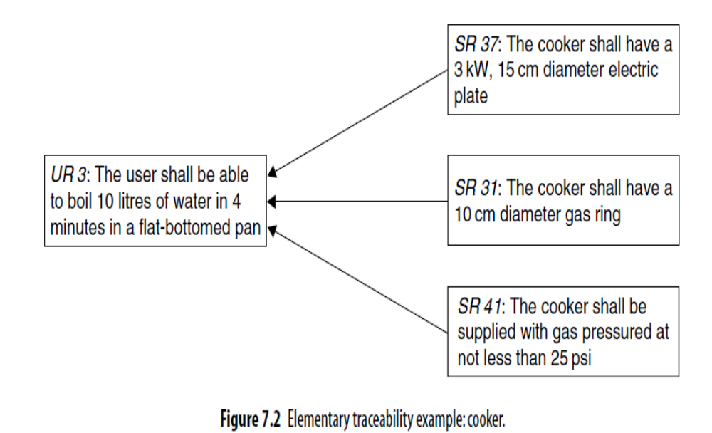
Example-2

Slide 11
Problems …
With the elementary traceability of these examples, the only information provided is that the system requirements play some kind of role in the satisfaction argument, but there is nothing to indicate exactly what the argument is.

Slide 12
Rich Traceability using Satisfaction Argument
Rich traceability is a way of capturing the satisfaction argument.
This appears as another statement between the user requirement and the corresponding system requirements, as illustrated in the following example.

Slide 13
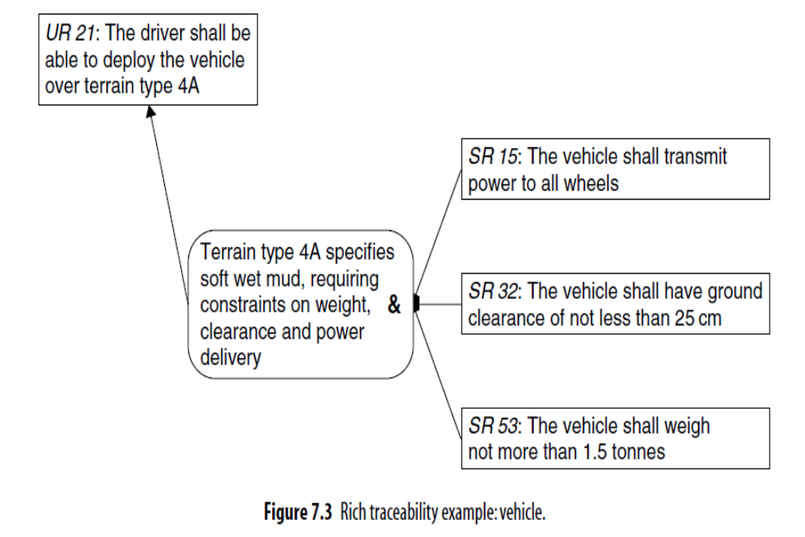
Example-3

Slide 14
Conjunction (&), Disjunction (or)
Not only is the satisfaction argument expressed textually, but an indication is given about the way in which the system requirements combine in the argument using a propositional operator by:
conjunction (&), indicating that the contribution of all the system requirements is necessary for the user requirement satisfaction argument to hold;
disjunction (or), indicating that the contribution of any one of the system requirements is necessary for the user requirement satisfaction argument to hold.

Slide 15
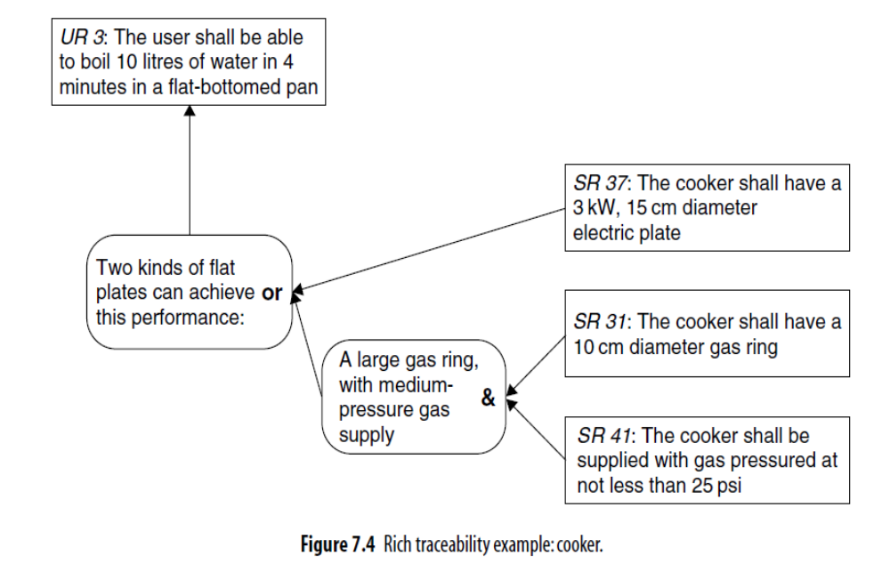
Example- 4

Slide 16
An example of disjunction
In the previous example, where satisfaction is achieved through provision of either an electric ring or a gas ring or both.
Note the two-level propositional structure of the argument.
Much more information is now provided about how the user requirements are being satisfied.
Even one who is not a domain expert may feel capable of assessing important aspects of the argument.
The operator makes the structure of the argument more precise.

Slide 17
An example of disjunction – Contd…
It was not at all clear in Example-2 that the set of system requirements represent alternative solutions.
Whereas in Example-4, the fact is made absolutely specific.
If an electric ring cannot be supplied, the requirement can still be satisfied through a gas ring.

Slide 18
Role of domain knowledge
Satisfaction arguments may depend for their validity on things other than lower level requirements.
Following example uses “domain knowledge” to support the argument.
Domain knowledge is a fact or assumption about the real world and not something that constrains the solution in itself.
In this case, the statement of domain knowledge is an essential part of the satisfaction argument, shown in a slanted box.

Slide 19
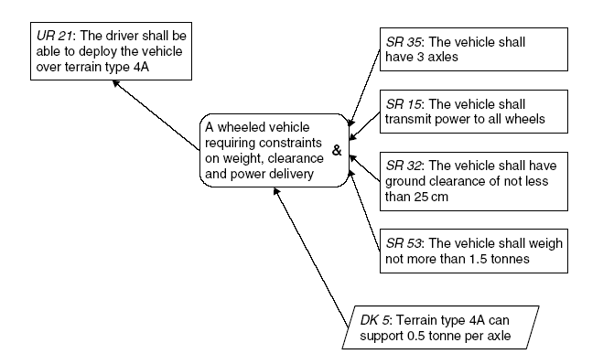
Example- 5

Slide 20
Multiple layers of rich traceability.
Rich traceability can, of course, be used through multiple layers of requirements or objectives.
Example-6 depicts three layers and the traceability between them.

Slide 21
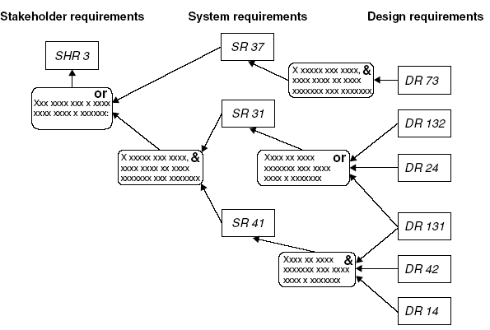
Example-6

Slide 22
Implementing Rich Traceability
There are two approaches to the implementation of rich traceability:
  Single layer, and
  Multi-layer.

Slide 23
Single-layer Rich Traceability
In this approach, as illustrated in Example 7, each high-level requirement has a single statement of satisfaction or strategy as an attribute, and
multiple low-level requirements may flow from it in a many-to-many satisfaction relationship.
Another attribute may be used to type the argument as either a conjunction or a disjunction.

Slide 24
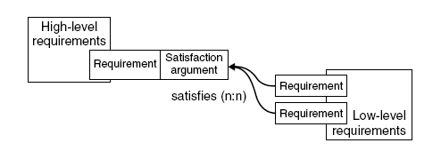
Example-7
Single-layer Rich Traceability

Slide 25
Multi-layer Rich Traceability
Here satisfaction arguments can be structured into multiple layers:
a main argument attached (as an attribute or linked in an “establishes” relationship) to the requirement to be established, and
a hierarchy of sub arguments hang off of the main argument.
This is shown in Example 8.

Slide 26
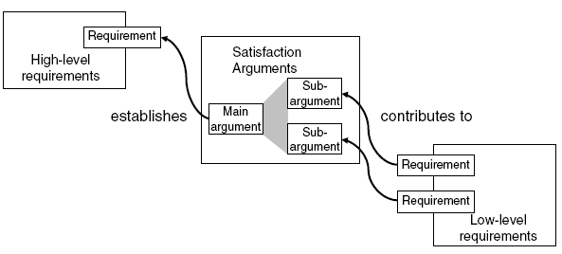
Example-8
Multi-layer Rich Traceability

Slide 27
Metrics for Traceability
There are three dimensions of traceability
Breadth: how well does the relationship cover the layer?
Depth: how far down (or up) the layers does the relationship extend?
Growth: how much does the relationship expand down through the layers?

Slide 28
Metrics for Traceability Contd…
To help in determining which aspects of these dimensions are useful in terms of measuring the requirements engineering process, it is necessary to distinguish between two types of metrics:
Phase metrics: measurements relating to a single stage of development, e.g. just to the systems requirements layer.
Global metrics: measurements spanning several stages of development.

Slide 29
Breadth
Breadth relates to coverage and as such is a phase metric.
Coverage can be used to measure progress of processes that create traceability at a single stage.
It focuses on a single layer and measures the extent to which requirements are covered by the adjacent level above or below.

Slide 30
Depth
Depth looks at the number of layers that traceability extends upwards or downwards from a given layer, making it a global metric.
One application may relate to determining the origins of requirements of the lowest level.

Slide 31
Growth
It is related to potential change impact.
How many requirements at lower levels are related to a single requirement at the top level?
In the following examples, four situations are contrasted.

Slide 32
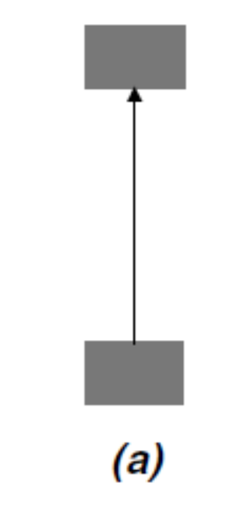
Growth - Case (a)
A single requirement is satisfied by a single requirement at the next level down.
The growth factor is 1.

Slide 33
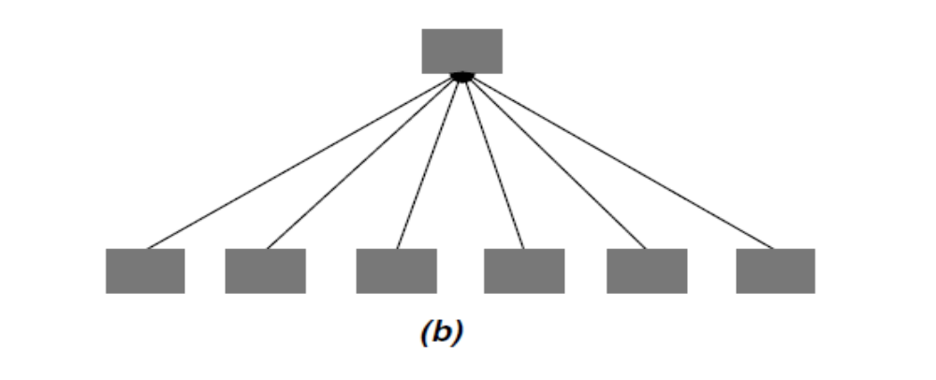
Growth - Case (b)
The single requirement is met by 6, giving a growth factor of 6. Possibilities are:
Requirement may be poorly expressed, and needs decomposing into several;
Requirement may be inherently more complex than (a), and therefore may need special attention;
Changing requirement will have more impact than changing (a), and therefore needs special attention.

Slide 34
Growth – Contd…
An apparent imbalance at one level may be addressed at the next level down.
This is illustrated by cases (c) and (d), where the growth factor two levels down is identical.
What could be deduced from this?

Slide 35
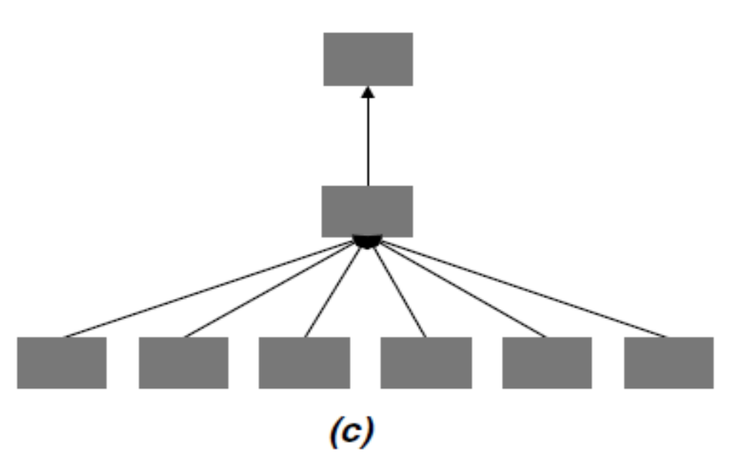
Growth - Case (c)
Possibility is:
  The top requirement in (c) was at a level too high;

Slide 36
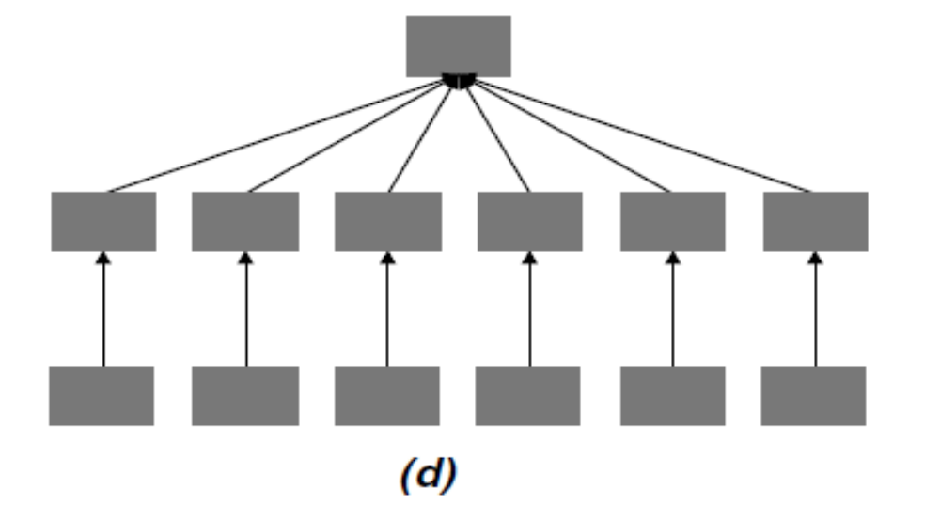
Growth - Case (d)
The middle requirements in (d) were at a level too low.

Slide 37
Growth – Contd…
Only after considerable experience in a particular organization developing particular kinds of systems could one begin to ascertain what growth factor of requirements between layers is to be expected.
More useful, however, would be to examine the balance of growth between requirements as a means of identifying potential rogue requirements, or imbalances in the application of process.

Slide 38
Balance
Balance for a metric is to look at the distribution of growth factors for individual requirements between two given layers, and examine those that lie in the outer quartiles of the distribution.
The goal is to identify requirements that have an abnormally high or low growth factor, and subject them to special scrutiny.
Figure 9 shows what a typical growth distribution may look like. The graph plots the growth rate against the number of requirements that possess that growth rate.
Most lie between 2 and 6, whereas a few have only 1 or more than 6. It is these latter requirements that should be identified and given special attention.

Slide 39
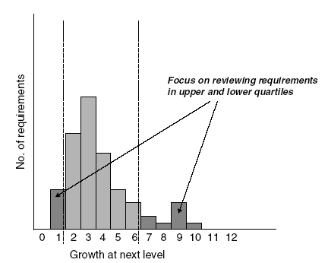
Frequency distribution of requirement growth
Figure - 9

Slide 40
Criticality of requirements
In Figure 10, Two requirements at the lower level have more than one requirement flowing into them.
They are perhaps more critical than others, since they satisfy multiple requirements, and should therefore be given special attention.

Slide 41
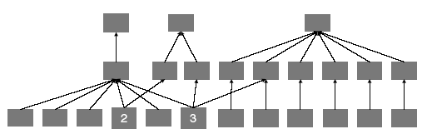
Criticality of requirements.
Figure - 10

